Slide 1
Unisys InteliServe™ Overview
Transforming your service desk to align with the digital workplace
Tom Adams and Mark Alba

Slide 2

The State of the Service Desk
The complexity of today’s service desks results in an underutilization of innovations such as analytics and automation and over-reliance on costly human intervention to deliver mediocre support experiences.
Notes:
NOTES FOR INTERNAL USE ONLY. PLEASE REMOVE BEFORE SENDING PRESENTATION TO CLIENT. ALWAYS SHARE PDF
When we call support at work, we expect a level of service that is on par with what we would receive from any other area of our personal, consumer experience.
Helpful online knowledge bases, virtual assistants powered by automation and made precise by analytics, and if required – only if required human-based support.
But these technologies are complex, tough to implement and even tougher to manage.
What happens then - analytics are off the mark, automation doesn’t work and you’re screaming at a virtual assistant to get a “real” human on the line.
And human support is expensive.
There is a huge opportunity to fix this.

Slide 3
Service Desk Market Opportunity
Remove this slide before sharing with client
InteliServe™ is a “stand alone” service desk offering that can be sold with Desktop, Mobility and Field Engineering Services (FES)
Mobility positioned with a CAGR of 14.3%
The service desk market shows a 3 year CAGR decline of 1.7% reflecting the maturity of the existing managed service desk market.
We believe the actual opportunity for Unisys is a smaller market – but with higher growth based on the following factors.
Higher growth in mid-market – with 10% more organizations adopting outsourced models
Growth in market with autonomic and cognitive capabilities
Large US Organizations: 60% have outsourced this function; Gartner predicts this to grow to 67% over the next 3 years
Market Adoption of New Technologies ¹
Virtual Agents 40%
Autonomics/Cognitive <25% (due to enterprises waiting for this area to mature)
Service Desk Market Opportunity
-1.7% CAGR
Dollars in Billions
1 Source: ISG Provider Lens: Digital Workplace Services’ by ISG based on customer POCs
Notes:
InteliServe, our Unisys Managed Service Desk offering plays in the larger “Managed Workplace Services” market,
As defined by Gartner, this includes Field Engineering Services, Desktop Management and Mobility Services – in addition to Managed Service Desk
While the market is forecast to decline at -1.7% for the four year period ending 2020 – there are pockets of opportunity:
Higher growth in the mid-market – with more organizations adapting an outsourced model
Market growth driven by innovation – specifically analytics and automation.
Major vendors in the Microsegmentation Market include VMware (US), Cisco (US), Unisys (US), vArmour (US), Juniper Networks (US), OPAQ Networks (US), ShieldX Networks (US), Cloudvisory (US), Extra Hop (US), GuardiCore (MEA), Bracket Computing (US), illumio (US), Nutanix (US), and August Schell (US).
https://www.reportlinker.com/p05220270/Microsegmentation-Market-by-Component-Security-Type-Service-Organization-Size-Deployment-Type-Vertical-And-Region-Global-Forecast-to.html
https://www.prnewswire.com/news-releases/microsegmentation-market-worth-20387-million-usd-by-2022-659067493.html

Slide 4




Service Desk Contacts and Costs
Automation lower cost and drive efficiencies
Total annual contacts in small environment
Average service desk cost per contact
< 72,000
Support defined by digital workforce
^{$16.30}
Total annual
contacts in medium environment
72,000 -
220,000
15.2
Average annual contacts per end user
Total annual contacts in large environment
6,379
> 220,000
Average annual contacts per service desk FTE
Stats from Garter: IT Key Metrics Data 2018: Key Infrastructure Measures: IT Service Desk Analysis : Current Year, Published 11 December 2017
Notes:
Another way to look at the market is based on firm statistics on activity and cost.
What is interesting about the market is that – activity doesn’t vary wildly based on the size of an organization.
A small environment – let’s say a SME with 1,000 employees can see up to 72K support contacts in a year.
A medium environment – mid-market firms with up to 10,000 employees can reach up to 220K contacts.
And when you look at the costs – there is no economies of scale based on the size of the firm.
The Average cost per contact is $16.30.

Slide 5











Challenges Facing Traditional and Next-Gen Service Desks
Support defined by digital workforce
Disconnected without resolution
Managing the unmanageable
Unaligned with user and business
High cost support as a last resort
“Consumerization of IT”; users expect and demand same level of support as experienced in everyday lives and aligned with digital workplace
Siloed support services; requiring multiple calls, dropped calls, call-backs, loss of data and transaction history; drives costs up and productivity down
Resources required to manage complexity—technology, information flow, staffing and service levels--lack of skill set required and funds to address needs
High cost of human intervention for poor quality service drives users elsewhere leading to higher hidden costs due to risks in security, privacy, compliance
Viewed as supporting function to the business; a “must have” for the wrong reasons; driving huge inefficiencies and loss of productivity for the user and business
Notes:
Let’s talk about the very real challenges organizations face with their existing service desk solutions.
As discussed – organizations no longer set the expectation for support performance. This is set by the consumerized digital workforce.
And because of silo-ed support services users experience discontinuous support across disconnected channels with no persistent record of the problem, dropped calls and higher support costs.
Support is tough – how does an organizations – especially a smaller one manage the complexity of data flow, staffing and finding the right skills to address the myriad support needs.
And as we discussed – due to this complexity – users often pivot to the high cost option for support – including shadow IT (i.e. DIY) or human agents.
This all results in a misperception of support services as being a cost center. A necessary evil required – but not a revenue generator.

Slide 6










User-Centric Integrated Approach to Transforming Your Service Desk
Customer focused design in mind
Break down silos and connect
Automation and managed services
Intelligent support through teamwork
Satisfy workforce; optimize business
Deliver consumer-like user experiences that are aligned with Digital Workplace
Connects users across all channels—from any device—with seamless, consistent support
Automation improves service delivery with self-service and other automated capabilities
AI and analytics drive intelligent support with blended virtual and human teamwork
Integral part of the business operations—a “win-win” for the user and the business
Integrated Cloud Based ITSM Platform
Notes:
With every problem there is a solution
To meet the performance expectations of your user – treat them like consumers and make sure their digital workplace—including support is delivered leveraging the most advanced capabilities available to consumer companies.
Breaking down silos requires the ability to connect users to any channel of support through a single user interface. A support team can be complex – but the user doesn't need to know.
To manage the spiraling costs of staffing, automate routine tasks so your highly paid human contact center can focus on the more complicated problems.
Leverage intelligence to learn from that past – providing users with the right support resource based on their issue.
Finally – by enabling productivity – change the perception of support from being a cost center to revenue driver.

Slide 7
What’s Changing
DSSC to InteliServe
Taxonomy
DSSC – current term used to describe Service Desk and portfolio team
InteliServe: Managed Service Desk Offering
Offering Management: team of resources focused on the enhancement of the offering
Offering
DSSC: point solutions, costed independently, optional
Future: single platform of integrated technologies costed as a unit
Solutioning
Current: utilize existing methods and tools within uVelocity
Future: All in rate structure that includes all of the people and tools.

Slide 8
Why is it Changing
DSSC to InteliServe
Current Service Desks are struggling to meet financial and contractual modeling
Solutions and contracts are being written in accordance with RFP expectations and at market competitive price points but neither the cost of services or capabilities have evolved with the market.
Our current contact center challenges:
Challenged in delivering the consistent multichannel experience
Inability to reduce costs consistently
Difficulty keeping up with the pace of change within the market
Use of technology providers identified as market leaders in the Gartner Magic Quadrants
Importance of this is that we need to demonstrate that we are partnering with market leaders in order to begin moving to the right in the Managed Workplace Services Gartner Magic Quadrant.

Slide 9

InteliServe^{TM -} Managed Service Desk
InteliServe™ is a managed service that is built on the InteliServe platform of integrated omnichannel, automation and advanced analytics technologies; secured by biometric authentication and backed by expert virtual and live agents.
Managed Service Capabilities
InteliServeTM Platform
Analytics
Follow the Sun, 24x7x365 services
All locations leveraging a single global infrastructure
Contact centers in Australia, New Zealand, China, India, USA, Hungary, Colombia, and Brazil
Field an average of more than 14 million contacts per year
All contact centers are certified International Organization for Standardization (ISO) 20000, 27001, 9001
Single point of engagement through convenient application
Delivers innovative Omni-channel
Advanced analytics
Artificial Intelligence
Robotic Process Automation
Integration with your preferred IT service management (ITSM) platform
CSAT Sentiment
Resolution Analysis Modeling
Volume Prediction Modeling
NLP & Clustering based ticket classification modeling
Industry best practice guidance and alignment
Best in Class analytical resources and tools
Lean Six-Sigma based approach
Notes:
$135 investments in all services including security and verticals, with $16M investment in Digital Workplace Services for 2018

Slide 10



InteliServeTM
Service Desk Transformation
Single Point of Engagement
Unisys InteliApp™ provides easy user access to omni-channel support
Better Outcomes Through AI
Intelligent virtual agents leverage machine learning to decrease resolution times
Personalized Service Platform
Built on an integrated service platform that guides users through a personalized support journey
Consumer-like user experience
Provides flexibility and choice
Simplification and personalization drives
greater adoption rates and increases satisfaction
Single, unified user experience
Initiative an action in one channel, and
seamlessly transit to another with history
Complete visibility with centralized control ensuring delivery of a simplified, personalized, consistent user experience
Intelligent virtual agents powered by artificial
intelligence (AI) and natural language processing
AI, analytics and machine learning continually
improve performance and maximize FCR
Automation eliminates recurring service requests
that are time consuming driving efficiencies

Slide 11
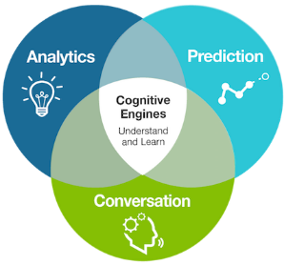



InteliServe Platform: ITSM Tools and Technology
InteliApp
Single point of engagement with Unisys InteliApp
Omnichannel support connects users across all channels
AI, robotics and analytics; automating user experience
Blending of intelligent
virtual and human agents
InteliServe Platform
Notes:
NOTES FOR INTERNAL USE ONLY. PLEASE REMOVE BEFORE SENDING PRESENTATION TO CLIENT. ALWAYS SHARE PDF
Unisys InteliServe™ platform integrates the tools and technologies to create the capabilities to deliver an intelligent user centric support experience that’s simplified, personalized and consistent
Single Point of Engagement with InteliApp™ – a Unisys proprietary application that provides users with “one-stop service at their finger tips” and a consistent support experience across all devices improving user adoption through simplified channel access
Omnichannel Personalization – connects an end user’s journey across channels—phone, email, web, video, chat, portal, mobile and social—seamlessly and consistently with transaction history that follows throughout
tracking transaction history throughout
AI Enabled Virtual Agent – With automation and artificial intelligence virtual agents become smarter, faster, more reliable and with machine learning, your intelligent agent will continually learn to enhance the end user experience. With virtual and human teamwork, users benefit with the most appropriate support for fastest resolution
Security is deeply embedded in the Unisys DNA and in our InteliServe™ offering; with such tools as biometric authentication, end users will have easy and secure access to the support they need.

Slide 12

Single Point of Engagement
Unisys InteliApp™ provides easy user access to omnichannel support
InteliApp—a Unisys proprietary application—is a consumer-like user experience that makes support easy to access and use
Provides flexibility and choice; enabling user to control when they want support and how they want it—anytime, anywhere, on any device
Directs user to fastest means of resolution ensuring most issues are resolved at first point of contact
Simplification and personalization drives greater adoption rates and increases satisfaction
Single point of engagement into an omnichannel experience
InteliApp
TYPICAL USE CASES
InteliServe Platform

Slide 13
Omnichannel Support
Transform your multichannel service into an user-centric omnichannel experience
Omnichannel support provides a single, unified user experience across all channels—phone, email, web, video, chat, portal, mobile and social
Enables user to initiate an action in one channel, and seamlessly transit to another with information stored across channels, meaning users won’t have to repeat anything they have already entered
Users can select the channel for the best experience, based on their preferences and environment
Provides complete visibility with centralized control over issues that ensures the delivery of a simplified, personalized and consistent user experience
InteliApp
TYPICAL USE CASES
InteliServe Platform

Slide 14

Better Outcomes Through AI, Robotics and Automation
Intelligent virtual agents leverage machine learning to decrease resolution times
Intelligent virtual agents powered by artificial intelligence (AI) and natural language processing (NLP)
AI, analytics and machine learning continually improve performance and maximize first-call resolution
Automation eliminates redundant activities—recurring service requests such as password reset and status checks—that are time consuming when executed manually; driving operating efficiencies
Analytics leverage automation to drive preventive techniques, take a proactive stance to resolution
Operational insights from analytics generate metrics for continuous improvement
TYPICAL USE CASES
InteliServe Platform
Notes:
3) Robotics ai
4) Contact center

Slide 15
Contact Center
Transforming the contact center with virtual and human teamwork empowered by AI & analytics
Omnichannel cloud contact center—accessible from anywhere, anytime, on any device—through InteliApp
Provides intelligent, simplified and personalized support through virtual and human teamwork; directing user through the route that maximizes first-call resolution
Analytics, conversation and prediction, help intelligent virtual agents understand and learn—continually enhancing the resolution experience with proactive and self-healing capabilities
Personalized to provide a profile-based experience and context-aligned support
Backed by a 24/7 global network of support resources—across cultures, languages and time-zones
TYPICAL USE CASES
InteliServe Platform

Slide 16
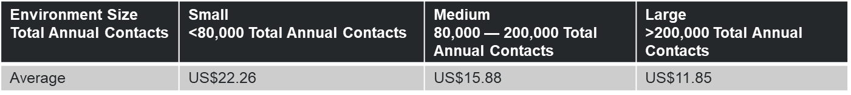
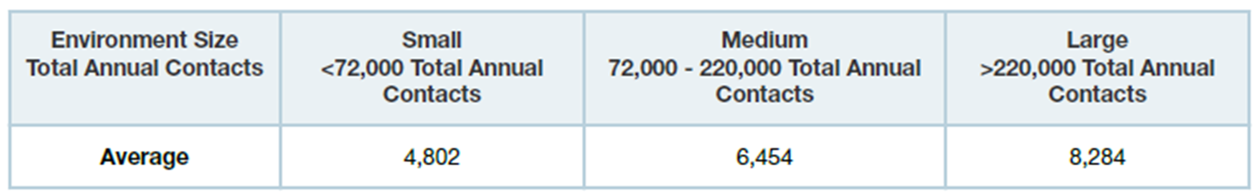
Ideal Customer Profile
Unisys Ideal Customer Profile | Benchmarking Data
Organizations struggling with low adoption levels of self-help or self-service implementations Consistent low customer satisfaction or precipitation by end users or business unit leaders. Cannot implement emerging contact channels due to legacy software and infrastructure Dispersed Service Desk’s
Job Title/Role | CIO | VP IT & CTO | Procurement VP or Staff
Buying Role | Key Decision Maker | Influencer | Influencer
What They Need | Ability to reduce operational costs Improved customer experience Ability to address business challenges Show continual innovation | Ability to reduce operational costs Improved customer service Service resiliency/stability High customer satisfaction Dependable service Innovation to drive efficiency/lower cost Consistent experience across all devices and channels | Commercial flexibility Value over time (financially)

Slide 17
InteliServe Cheat Sheet (Internal)
Remove this slide before sharing with client
Solution Support
Engage SA’s through deal pursuit process
SA’s will engage InteliServe team (Bobby) prior to uVelocity changes
1
Tom Adams
DWS Portfolio
Bobby Arbuthnot
Offering Manager
Service Desk
Travis Parker
Offering Manager
Productivity/Collaboration
End Point
Weston Morris
Analyst/Advisors
Catalina Villegas
Solution Owner
Contact Center
Colby Love
Solution Owner
Virtual Agent
Rob Esparza
Lead Architect
Michael Ray
Solution Owner
InteliApp / RPA
Milind Pol
Business Case Dev
Costing Configurators
2017 Win Analysis
Deal Size (m) | # Deals | Avg TCV (m) | Avg GM | Avg Pursuit Duration (months)
<1 | 42 | .20 | 25% | 3
1 - 5 | 19 | 1.9 | 24% | 8
5 – 20 | 9 | 4.4 | 21% | 12
>20 | 4 | 10.3 | 22% | 12
Andre Schwaer
Account Liaison
Solutioning Support

Slide 18
Use case — “Modernizing” the End User Experience
Banking giant engages Unisys to improve user support experience and gain cost efficiencies
CHALLENGE
SOLUTION
RESULTS
Leveraged current platform and tools while adding best-in-class technologies to deliver support capabilities required
“Modernized” their service desk by automating manual activities that drive simpler, smarter and faster resolution without human intervention
InteliServe platform backed by Unisys Security
Faster implementation, lower implementation costs without sacrificing service levels
Automation empowered users to meet their own needs quickly; freed up human resources for higher value activities; drove an enhanced user experience
Platform allows for continuous innovation while maintaining security, privacy and compliance
CIO of a large North America banking giant was newly hired to transform and modernize their end user experience with an “out-of-the-box” approach that lowers costs of implementation but built upon a more state of the art infrastructure without incurring any risks to security.

Slide 19
Use case — Integrating the Business with the Customer
Pharmaceutical company engages Unisys to improve productivity and user satisfaction
CHALLENGE
SOLUTION
RESULTS
Initial focus was to tackle dissatisfaction and productivity issues among end users by providing simple, easy access to support
Transitioned from multichannel to omnichannel support across all channels —phone, email, web, video, chat, portal, mobile and social
Implemented InteliServe platform integrated existing investments and new technologies
The VP of major pharmaceutical company needed to overhaul it’s service desk model to improve falling productivity that was impacting overall customer service. They sought a partner who could help them deliver support services that would improve user satisfaction, improve productivity and better integrate with their overall business .
Improved user productivity through InteliApp; ease and simplification increased adoption and satisfaction levels
Omnichannel support also improved adoption rate; maximized first-call resolution; complete visibility with centralized control over issues
InteliServe platform reduced costs beyond basic operational efficiencies

Slide 20







InteliServe Support Resources
Backed by a global network across cultures, languages and time-zones
PROVEN TRACK RECORD
12M+ contacts annually to Service Desk
7,630 clients in 100+ countries
252 multinational clients serviced globally
4.1M field dispatches per year
1.3 million desktops/notebooks supported
RESOURCES TO RESPOND
1,418 consultants
17 data centers
9 network operations centers
8 security operations centers
Hungary (Budapest/Pecs) ~590
English, German, French, Italian, Slovakian, Czech, Polish, Russian, Romanian, Hungarian, Turkish, Hebrew, Arabic, Dutch, Swedish, Portuguese, Indonesian, Canadian French, Italian
7x24
English, German, French, Russian, Hungarian, Slovenian
5x12
Shanghai, China ~140
Mandarin, English
7x24
Japanese, Korean, Cantonese
5x12
Salt Lake City, UT ~350 English
7x24
Augusta, GA ~350
English, Spanish, French Canadian
7x24
Manilla, Philippines ~250
English
7x24
Rionegro, Colombia ~300 Spanish
5X12
Hyderabad, India ~330
English
7x24
Sydney, AU ~80
English
5x12
Bogota, Colombia ~210 Spanish
7x24
Bangalore, India ~570
English
7x24
Campo Grande, Brazil ~310
Portuguese
5x12
Wellington, NZ ~60
English
7x24

Slide 21
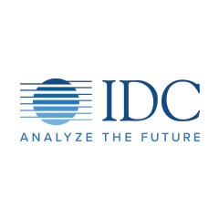

What Analysts are Saying About Unisys InteliServe
"Enterprises are looking to provide better experiences when it comes to service desk support. With InteliServe, Unisys has created a holistic offering to provide users with an omnichannel solution that uses deep analytics for quick access to service and resolution of issues”.
Rob Brothers
Program Vice President of Support Services
International Data Corporation (IDC)
May 2018

Slide 22
Digital Workplace Services Another innovative offering in the Unisys portfolio
Unisys Products, Services & Solutions
Security Solutions
Digital Workplace Services
Digital Transformation Services
Advanced Analytics
Managed Security
Security Consulting
Stealth™ Microsegmentation
Stealth™ Identity Management
Productivity & Collaboration
Service Desk Transformation
InteliServe™
Field Engineering Services
Hybrid Cloud
Service Integration and Management
Data Center Managed Services
ClearPath Forward®
Workspace Automation
Operation Optimization
Risk Management
Pricing Optimization

Slide 23
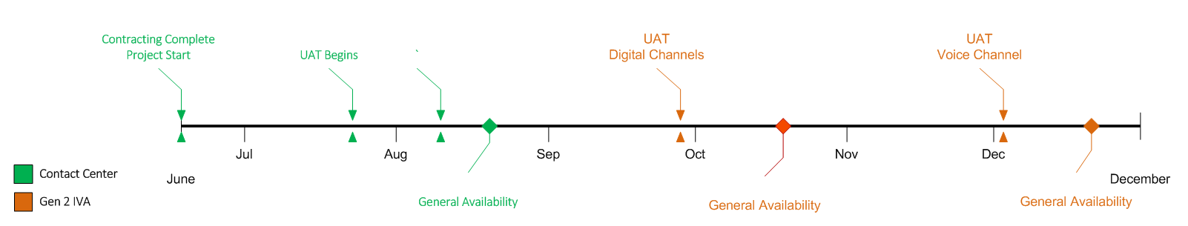
Roadmap

Slide 24
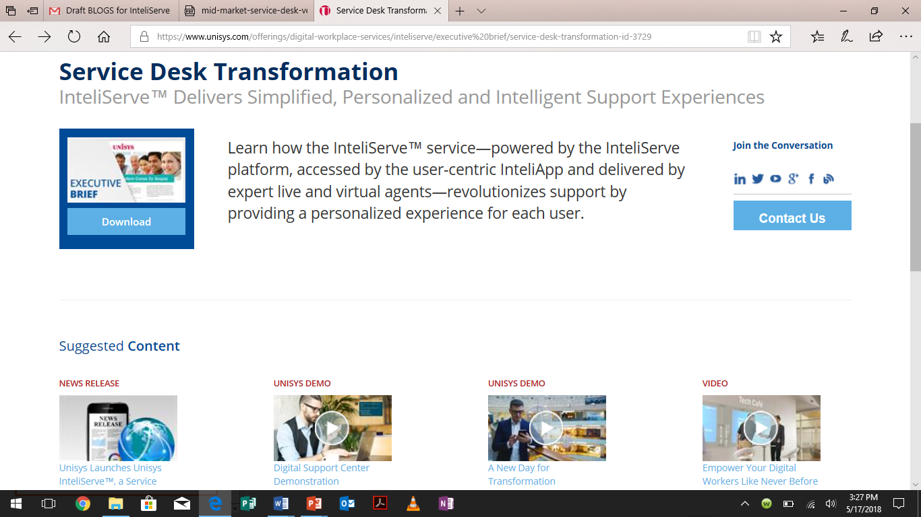
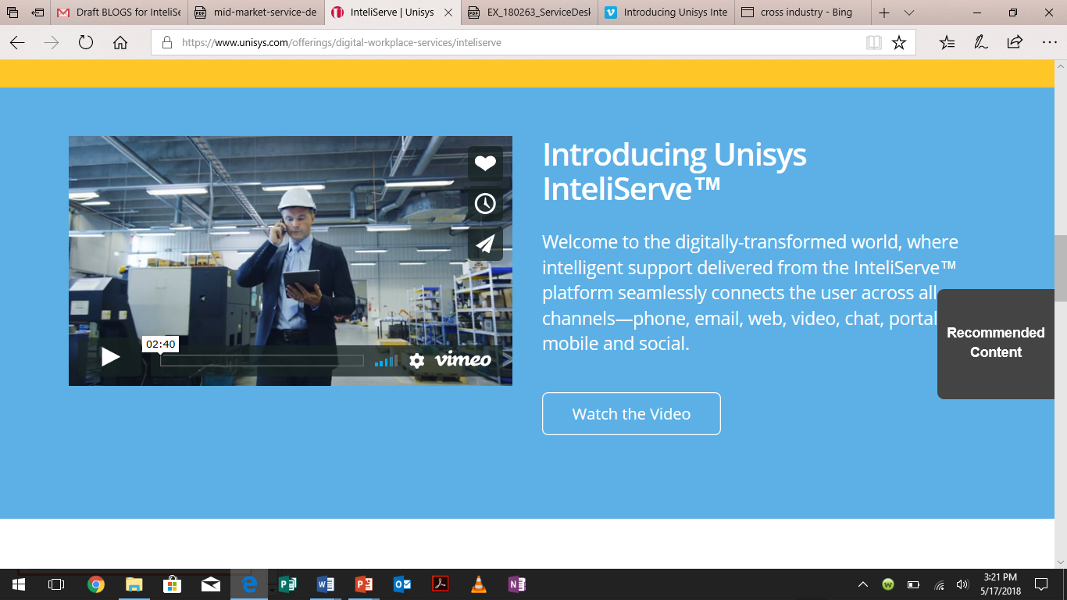

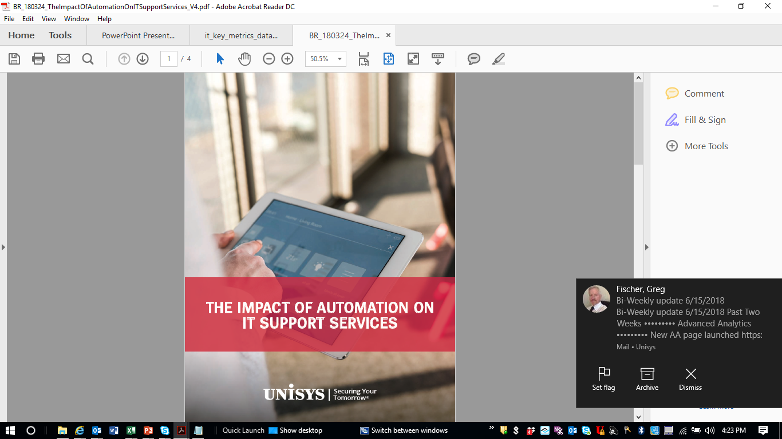
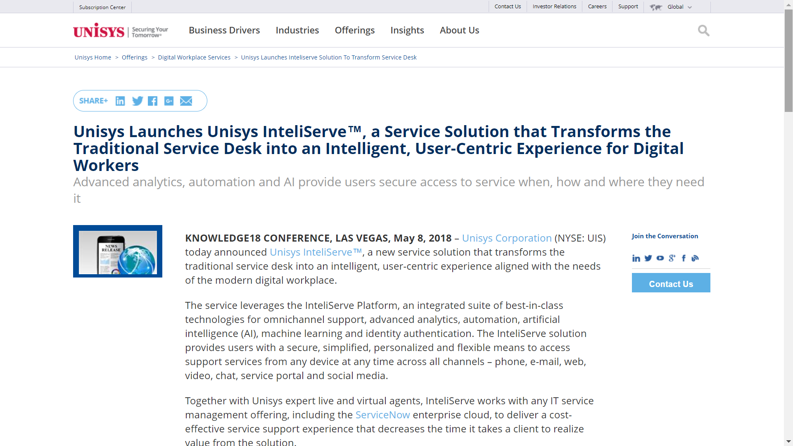
Additional Resources
Remove this slide before sharing with client
Unisys.com – Executive Brief, Video, Demo, Blog, Press Release
Demand
Generation Campaign
Planned for Q3
Unisys Digital Workplace Divide Report To Release 6/26
https://www.unisys.com/offerings/digital-workplace-services/inteliserve
Internal Resources for sales / account engagements
External Resources for your prospects / clients
https://unisyscorp.sharepoint.com/sites/solutioncentral/Pages/InteliServe.aspx

Slide 25

www.unisys.com/inteliserve

